Slide 1
Salesforce Admin for Beginners
Chapter -02
Contents
Salesforce Objects
Fields
Field Types
Relationships
Schema Builder

Slide 2
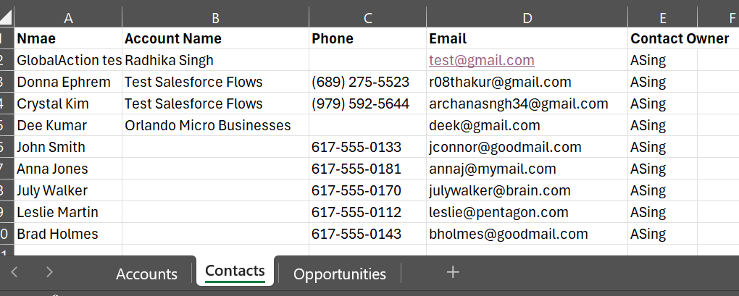
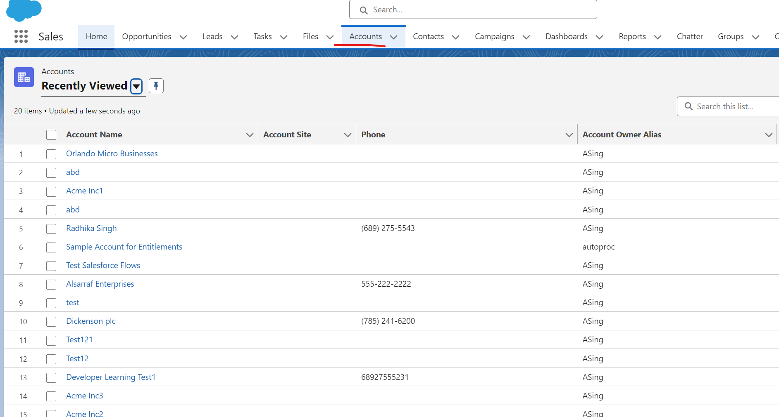
Objects
Objects are database tables that allow you to store data specific to an organization. Salesforce objects and fields are analogous to database tables and the table columns.
Standard Objects
Custom Objects
Standard Objects
Custom Objects
These objects come out-of-the-box with Salesforce and are built into the platform. They include common business objects like
Account: Represents an individual customer or an organization.
Contact: Represents a person associated with an account.
Opportunity: Represents a potential sale or deal.
Lead: Represents a prospective customer.
Case: Represents a customer issue or problem.
Campaign: Represents a marketing campaign.
User: Represents an individual user of Salesforce.
These are objects created by Salesforce users to store information specific to their business needs that aren’t covered by standard objects. For example, a company might create a custom object called "Project" to track details about various projects.
Standard Objects | Custom Objects
Standard Objects are out of box | Are user defined
API names does not ends with __C | API names ends with __C
Limited Customization | Fully Customizable
Ex. Account, Contact & User | Ex. Project__c

Slide 3
Components of Salesforce Objects
Main components of Salesforce Objects are:
1. Fields
3. Page Layouts
3. Relationships
Columns in the table, representing data points.
Examples: Name, Email, Phone etc.
Determine how the fields on an object appear on the user interface.
Connections between objects, which can be one-to-many, many-to-many, or one-to-one.
2. Records
4. Validation Rules
6. Workflows and Triggers
Rows in the table, representing individual entries.
Examples: a specific Account or Contact
Ensure that data entered the object meets certain criteria.
Automate processes and actions based on changes to records in the object.

Slide 4
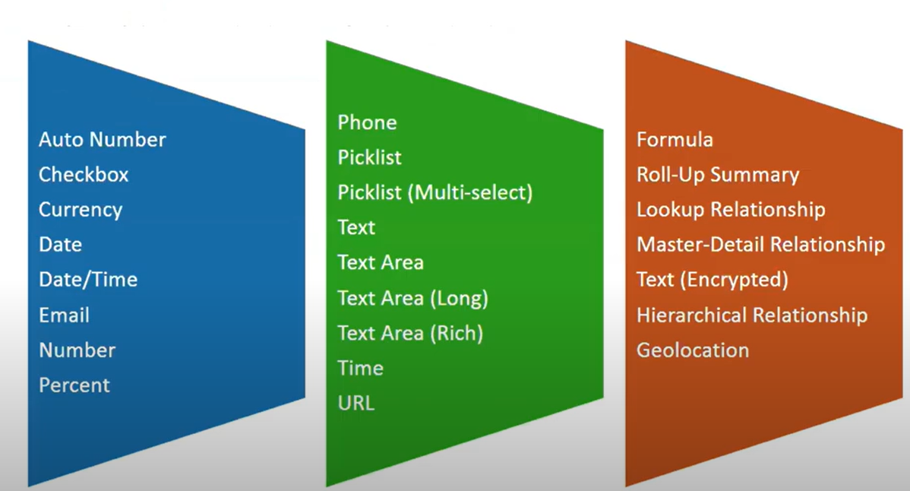
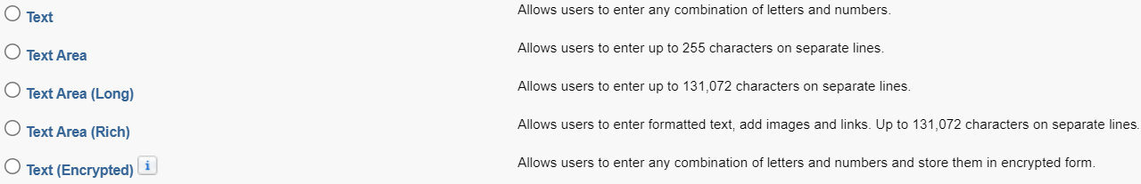
1. Fields
Standard Fields:
Field that are created at the time of the creation of an object.
There are four standard fields in every custom object that are Created By, Last Modified By, Owner and the field name
These fields cannot be deleted or edited, and they are always required.
For standard objects, the fields which are present by default in them and cannot be deleted from standard objects are standard fields
Custom Fields:
The Custom fields which are created by the user to meet the
business requirements of any organization.
They may or may not be required
Field Data Types in Salesforce

Slide 5
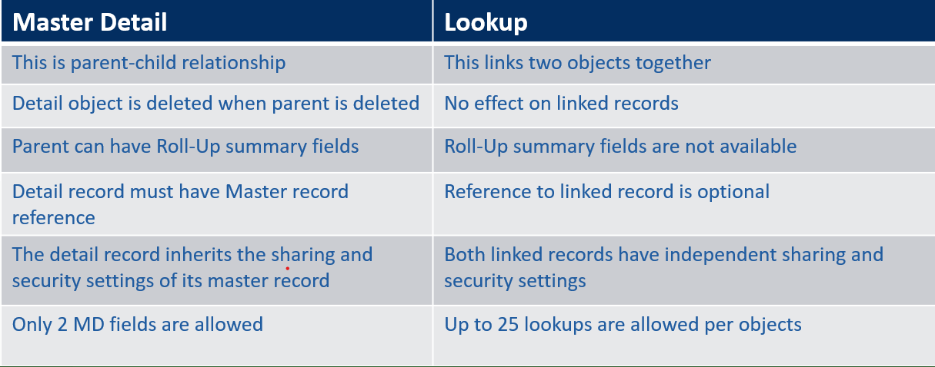
Roll Up summary fields
These can be used to display the sum, maximum, and minimum value of a field in a related list, also the count of all the records listed in a related list.
They are only available to master objects in a Master-Detail Relationship.
After creating a Roll-Up Summary Field on an object, the Master-Detail Relationship cannot be converted into a lookup relationship
Relationships in Salesforce
Using relationships, we can link objects with each other, and we can make connections and display data about other related objects.
To create relationships between two objects, we use relationship fields. The field is created on the many side object, and it is related to the one-side object.
Relationships (Master-Detail vs Lookup
Types of relationships in Salesforce
1. Master Detail
2. Lookup

Slide 6
Hierarchical:
A special lookup relationship is available for only the user object.
It lets users use a lookup field to associate one user with another user.
For example, You can create a custom hierarchical relationship field to store each user’s direct manager
Self:
When an object has a lookup with itself, it is a self-relationship
Many to Many
It allows each record of one object to be linked to multiple records from another object and vice versa.
To create a many-to-many relationship, simply create a custom junction object with two master-detail relationship fields, each linking to the objects needed to relate.

Slide 7

Data Modelling (Job Applications)
Micro businesses company want to track their job applications.
Name
Description
Address
Website
Phone
Ownership Type
Company
Master-Detail
Name
Company
Role Overview
Location
Requirements
Estimated Salary
Job Openings
Contacts
Master-Detail
Master-Detail
Applications
Application Number
Job
Contact
Resume
Open to relocation
Estimated Joining Date
Things to Learn:
Create custom Objects
Create Custom Fields
Create relationships

Slide 8
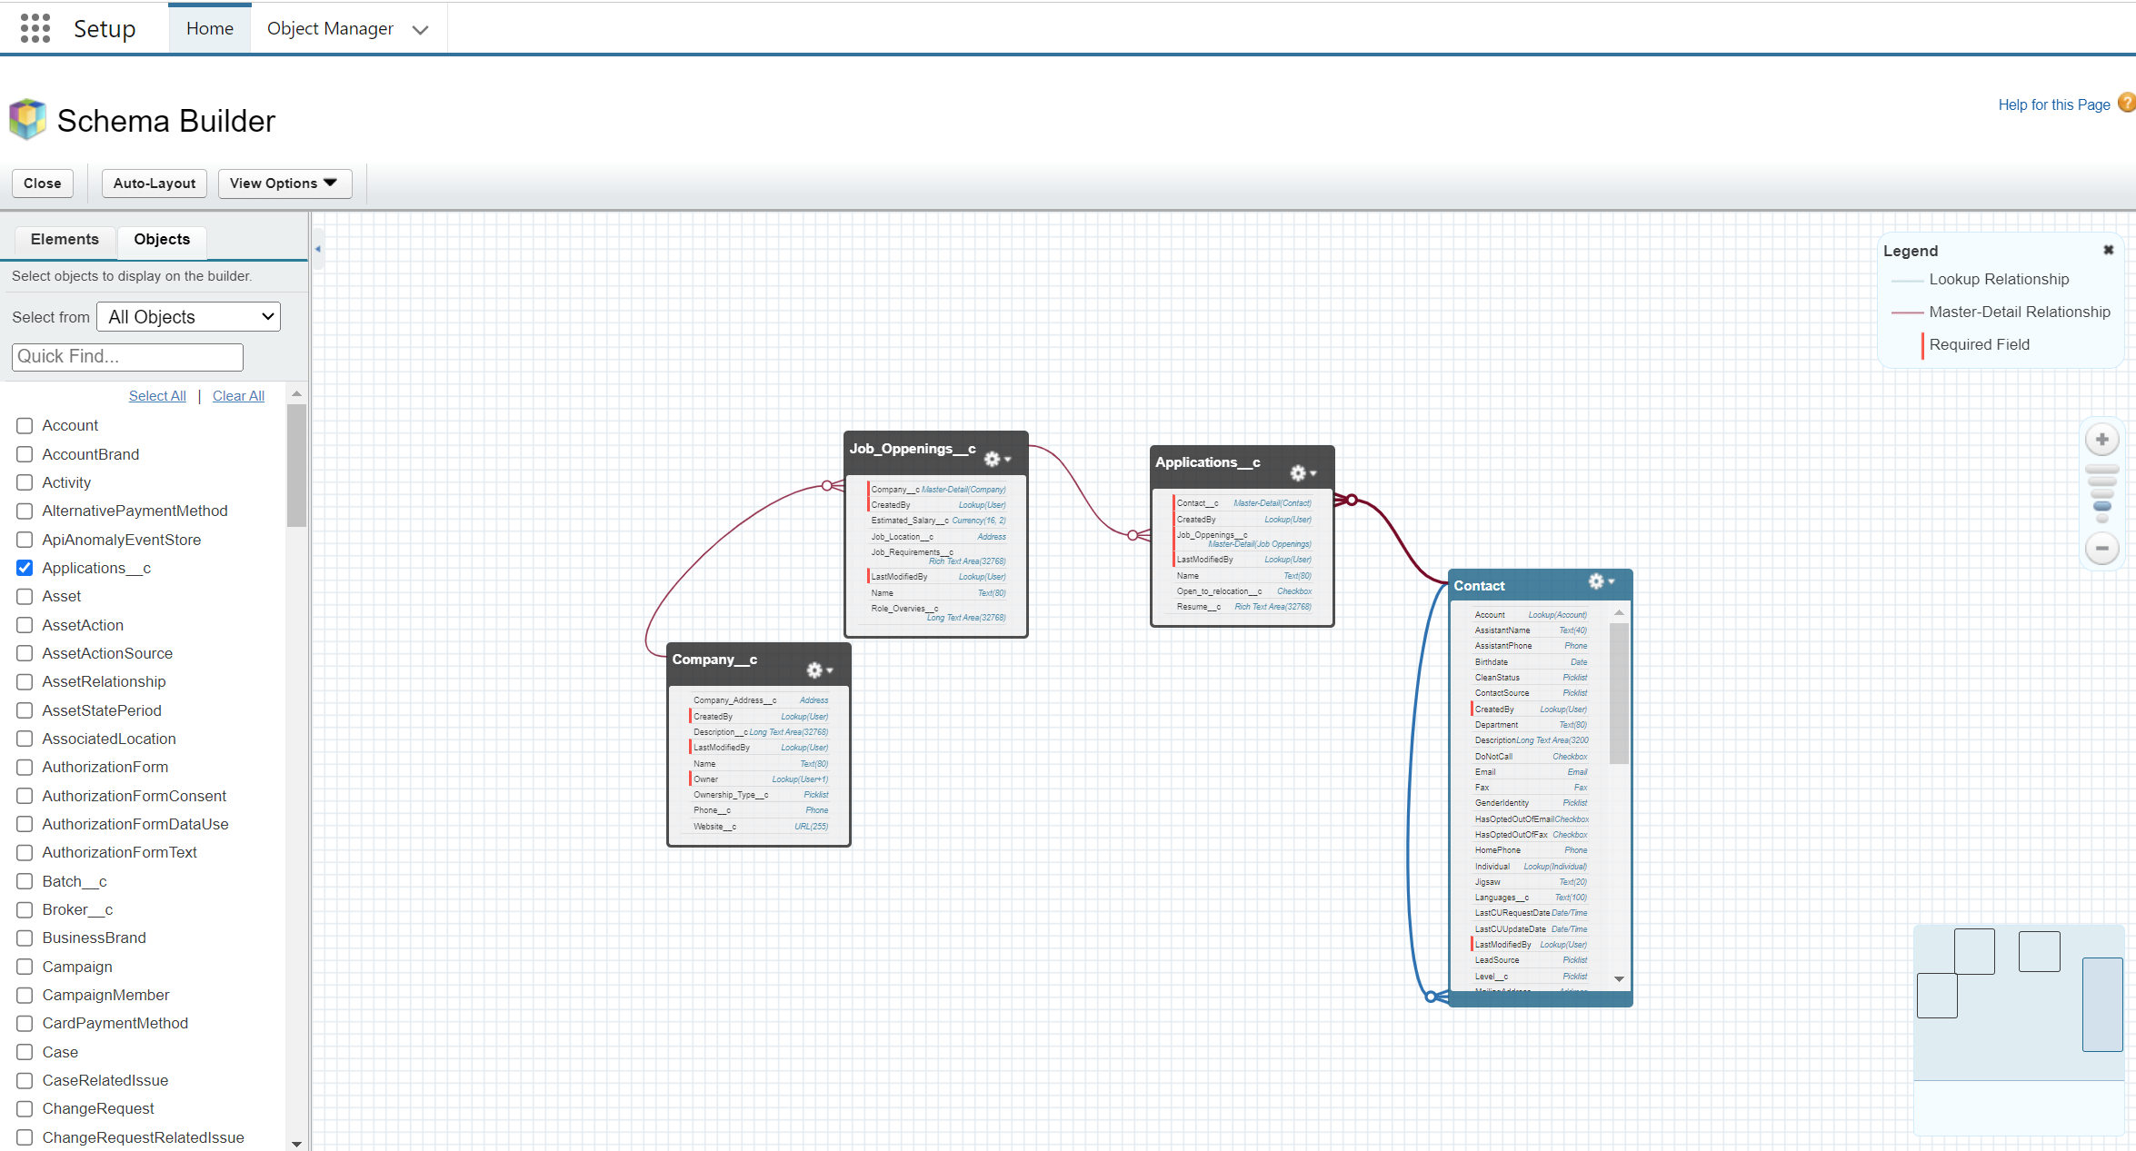
Schema Builder:
It can be used to view existing schema and interactively add new custom objects, custom fields, and relationships, simply by dragging and dropping.
Schema Builder is enabled by default and lets administrators add the following to
the schema:
❖ Custom objects
❖ Lookup relationships
❖ Master-detail relationships
❖ All custom fields except Geolocation

Slide 9
Data Modelling Example for Practice
DAHouse Reality want to track all the offers made to buy a property. Model this data in salesforce.
Property Name
Price
Bedrooms
Bathrooms
Square Footage
Price/Square Ft.
Listed Date
Location
Property
Master-Detail
Steps:
Create a Custom object Property
Create custom fields, Price (currency), Bedrooms (Picklist), Bathrooms (Picklist), Square Footage (number with decimal places), Price (Currency) and Listed Date (Date)
Create a Custom object Offer
Create custom fields, Property (master-detail), Offer Amount (currency), Target close date (Date)
Create an app “DAHouse Reality” and add both the tabs to the app
Data model is ready.
Offer Number
Property
Offer Amount
Target Close Date
Offers

Slide 10


